Slide 1
Data Essentials L3 DAY 2
Module 2: From Data to Insight

Slide 2

Power query access
Check if you have the Power Query feature in your Excel.
Notes:
If not done in day 1, all learners to check if they have PQ using the ‘Get data’ option.
Assign VMs to those who don’t.
Ask learners to have a look around the interface whilst you assign VMs to others.

Slide 3
Data blending

Slide 4
Data Blending
What, why, how?
What does it mean to ‘blend data’ together?
Examples of data sources that can be used to blend data.
What are the benefits of data blending?
Methods of data blending.
Examples of data blending from your own role / organisation. If not applicable, general examples of data blending from any industry.
Think, research, take notes.
Share with class.
Notes:
15 mins to think, research and make notes.
Discuss as class.

Slide 5
Data Blending
Methods
Lookup functions (VLOOKUP, XLOOKUP, etc.)
Joining data (horizontally)
Merging data (vertically)

Slide 6
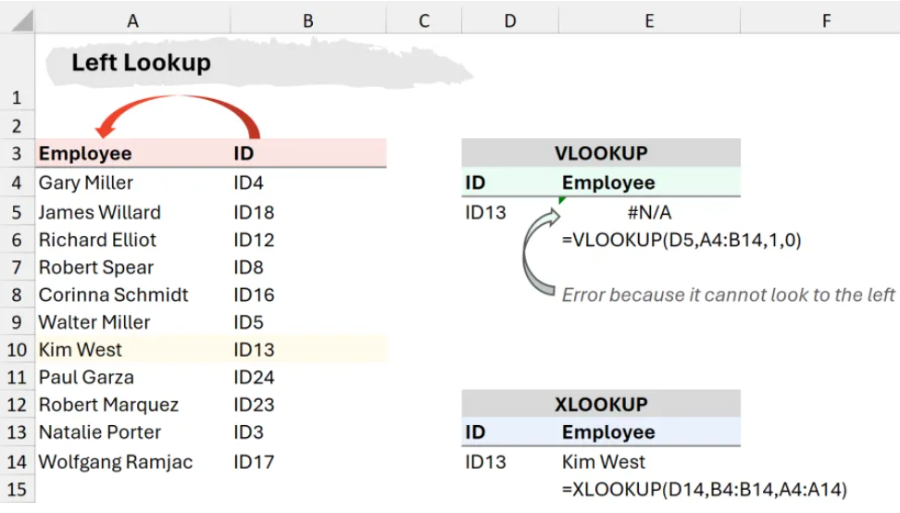
VLOOKUP
XLOOKUP
INDEX and MATCH
Lookup functions

Slide 7
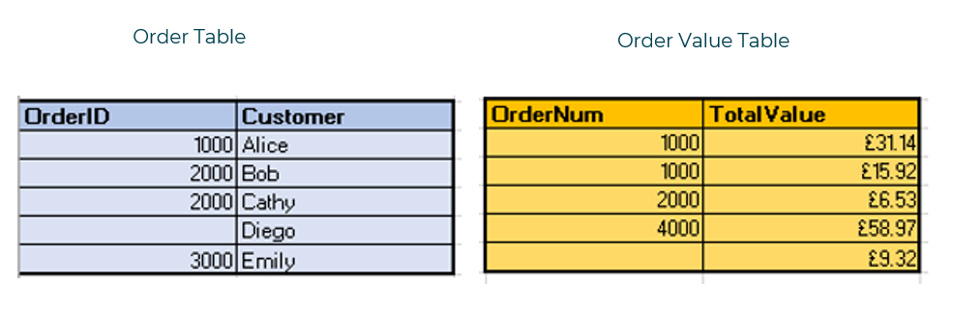
JOINING
Merging data
New columns are added.
Based on there being a matching unique field in both tables (needed to join).

Slide 8
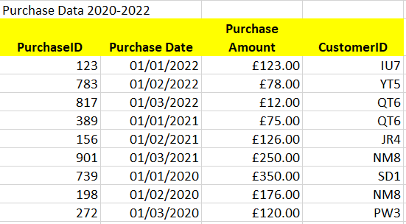
appending data
New rows are added.

Slide 9
Lookup functions

Slide 10
KSBs
Lookup Functions
S5₁ Manipulate and link different data sets as required.

Slide 11
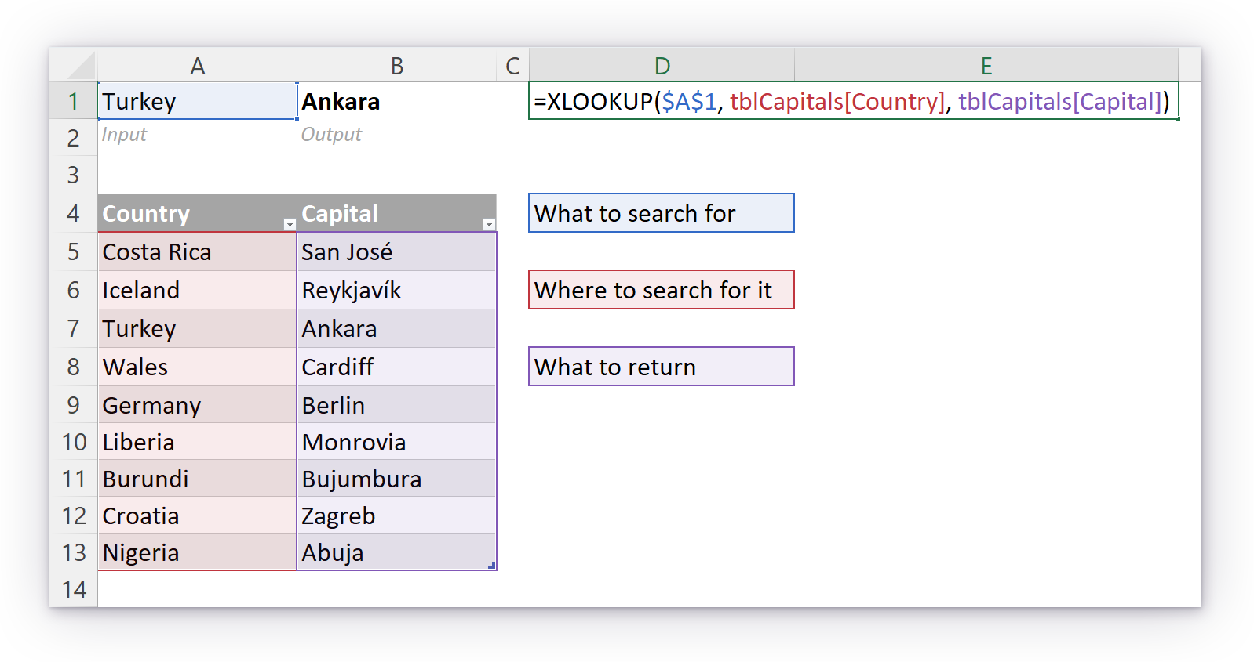
XLOOKUP()
Open file
‘Learner Guide - Practice with XLOOKUP.pdf’
Notes:
APPROX 20 MINS (suggest they add headers for all the lookup and return values for readability)
First Demo use of XLOOKUP using the 5 arguments.
Use demo version of the Superstore data to demo: Day 2 Demo (XLOOKUP) Superstore.xlsx
*** Important ***
There are still a few learners on pre-365 versions of Excel. If the group contains any such learners, they should be instructed in how to use INDEX() and MATCH() as a substitute for XLOOKUP().
Key learning points:
How to use XLOOKUP() on example data.
XLOOKUP() as a modern replacement for VLOOKUP(). VLOOKUP() is worse in every respect except backwards-compatibility.
Suggestions for additional teaching:
`if_not_found` parameter.

Slide 12
Joining tables

Slide 13
KSBs
Joining Tables
K6₁₊₂ The value of data to the business. How to undertake blending of data from multiple sources.
K9₁ Basic statistical methods and simple data modelling to extract relevant data and normalise unstructured data.
S3₁ Summarise and explain gathered data.
S4₁ Blend data sets from multiple sources and present in format appropriate to the task.
Notes:
Some uncertainty about whether S3 will be fully satisfied by the “Experiments with Joins” activity (WIP).

Slide 14
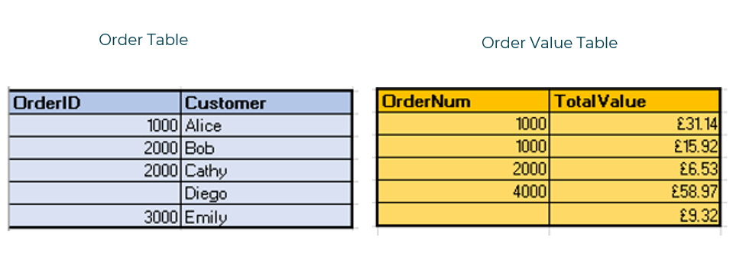
Joining Tables
Notes:
Introduce the tables.
Ask learners to:
What is the benefit of joining the two tables?
What is a unique identifier? Use examples (customer table, Tesco database, college database, NHS database)
Which one exists here in both tables?
In order to join them, why do both tables have to have a common identifier?
Can a name/surname be a unique identifier?

Slide 15
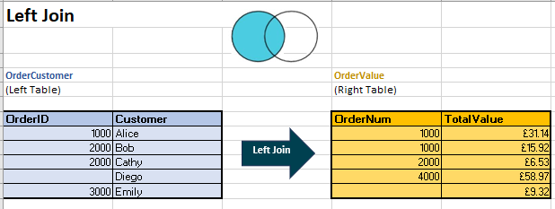
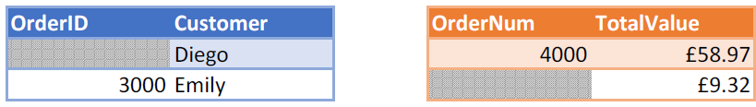
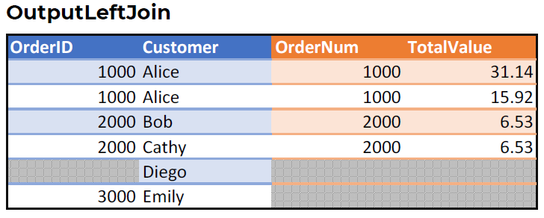
Joining Tables
Left join

Slide 16
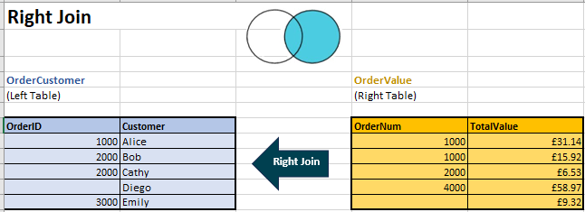
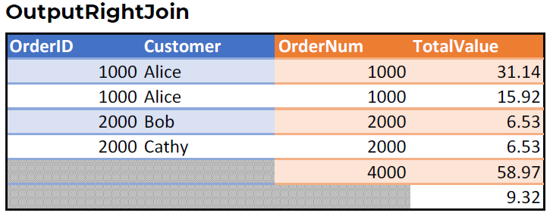
Joining Tables
Right join

Slide 17
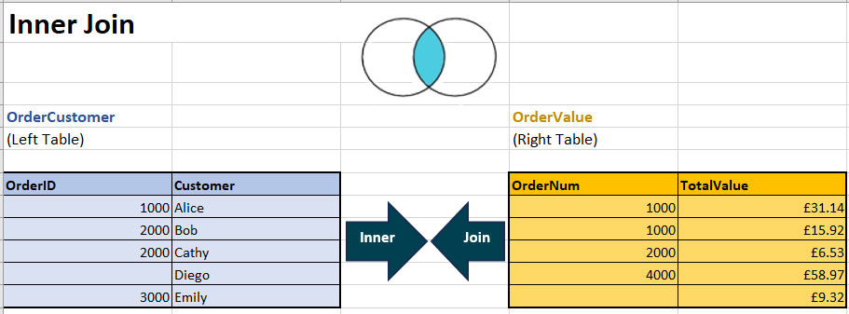
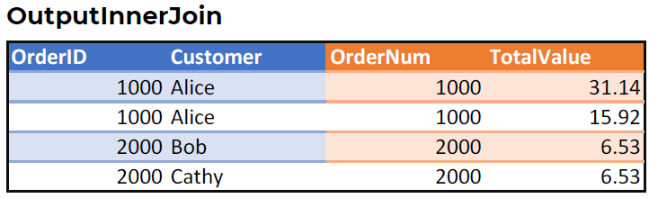
Joining Tables
Inner join

Slide 18
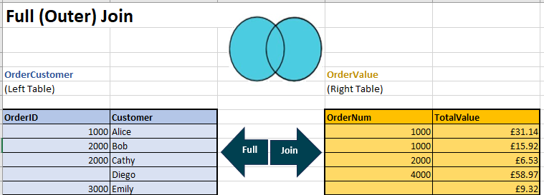
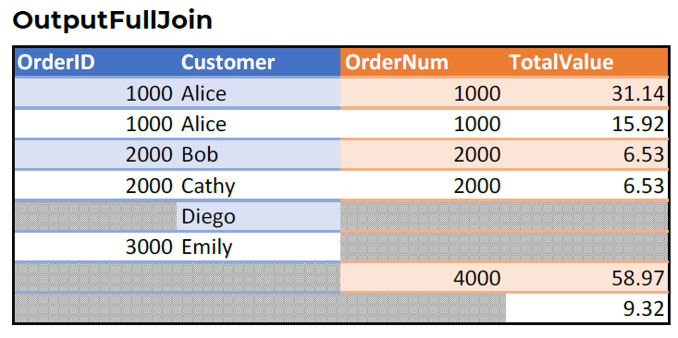
Joining Tables
FULL(outer)
join

Slide 19
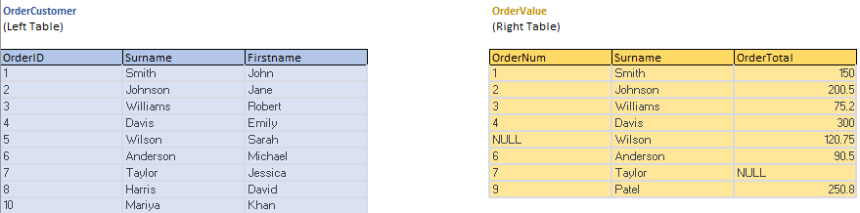
Experiments with Joins
Open file
‘Joins Playground.pdf’
Notes:
“Joins Playground” will allow learners to paste data directly into Excel and perform an {inner, left, right, outer} join using an intuitive interface.
The activity will run learners through a series of experimental joins until they have a strong intuitive understanding of the four basic types of join.
The activity may also satisfy S3 (“Summarise and explain gathered data.”) but this is currently uncertain.

Slide 20
Lookup Formulas vs. joins
Question
Could this left join operation be achieved in Excel using only lookup functions such as XLOOKUP()? (No copy and paste!)
If so: prove it!
If not: explain why not.
Notes:
Give learners no more than around 20 mins to think about the question and run their experiments.
For clarity: we are asking if we can achieve a dynamic left join using lookup functions alone. Dynamic: if we change the contents of the input tables, the output table updates correctly.
A: It is not possible to perform this join using only lookup functions and no copy & paste. Reason: the output table contains multiple matches for certain rows, e.g., “1000 | Alice”. A lookup function can’t return all matches—only the first match.
Side note: it actually is possible using more advanced formulas. If an advanced learner manages to write a LeftJoin LAMBDA() function then obviously they get full brownie points.
If any learner claims they have achieved a dynamic left join using only lookup functions, ask them to add a new row to the Left Table. Does the output table now contain the new row? Probably not!
Key learning points:
Lookup functions can’t do everything! Joins are not “pointless”! Some learners need to see this from themselves to understand.
A join returns all matching rows between two tables.
A lookup function returns only the first match.

Slide 21
Joins
Knowledge check: Joins
Question 1
What are the four basic types of join introduced earlier?
A: Middle, left, right, full
B: Up, left, right, down
C: Inner, left, right, full
D: Inner, left, right, outer
Notes:
A: C – Inner, left, right, full.

Slide 22
Joins
Knowledge check: Joins
Question 2
In a left join, which rows are guaranteed to make it into the output table?
A: All rows from the Left Table
B: All rows from the Right Table
C: All rows from both the Left and Right tables
D: No rows are guaranteed to make it into the output table
Notes:
A: C – Inner, left, right, full.

Slide 23
Joins
Knowledge check: Joins
Question 3
Which type of join do we need if the output table must contain only rows from the Left Table that have a match in the right Table and vice versa?
A: Inner join
B: Left join
C: Right join
D: Full join
Notes:
A: A – Inner join. Only the matched rows from each input table are returned.

Slide 24
Join (merge)
data
Power query
Open file
‘Merge Data For PQ..xlsx’
Notes:
If time, demo all joins (and append, next slide).
If short on time, demo only left and inner join.
Demo merge – left, right, inner and outer joins using PQ, learners to follow along.
Afterwards, they can check it against their initial join (manual) activity outputs.

Slide 25
Append data
Power query
Open file
‘Append Data For PQ.xlsx’
Notes:
Demo append using PQ, learners to follow along.

